Slide 1
Auto-ISAC ACT Advanced Wireless Lab - 2026
FCC ID
Bluetooth
  Scanning
  Enumerating
  Identifying
  Analyzing
  Pairing
  Data
WiFi
  Analyzer
  WiFite
  HackISAC
NFC
SDR
  FM Radio
  Keyfob record
  Keyfob replay
  Keyfob decode
Cellular
GPS
Headunit
RDS

Slide 2
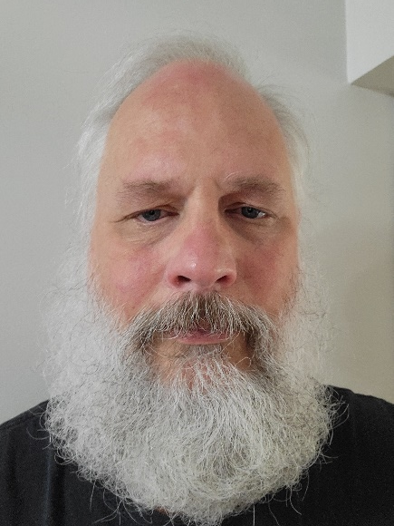
Who am I?
Neal Probert neal.probert@nissan-usa.com
NNA VSOC Lead, Senior Cybersecurity Engineer
Nissan Technical Center North America (NTCNA)
Research & Development, Technical Planning & Research
Neal Probert - Nissan Technical Center North America | LinkedIn
Auto-ISAC Certified Automotive Security Engineer (CASE)
Auto-ISAC ACT Advanced Wireless Lab instructor
SAE 21434 Automotive Cybersecurity Certification (ACC) L1 & L2
At Nissan, prior to Cybersecurity I was heavily involved in Vehicle to Vehicle (V2V) and Vehicle to Infrastructure (V2I) work with the Crash Avoidance Metrics Partnership (CAMP) with multiple OEMs. Btw, my career started out at Ford Research where I got the Henry Ford Technology Award.
My background is in Software Engineering and Networking. I have worked as a software developer and system/network administrator.
Linux/Unix, Python, C/C++, Java, PHP, Perl, SQL, …
HAM Radio: KD8NVN

Slide 3
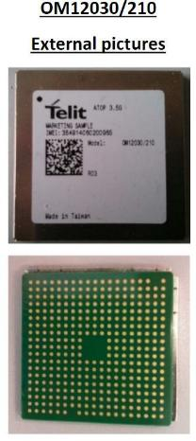
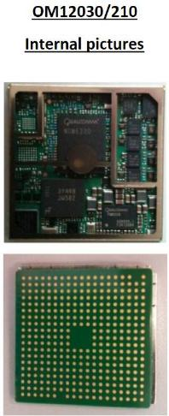
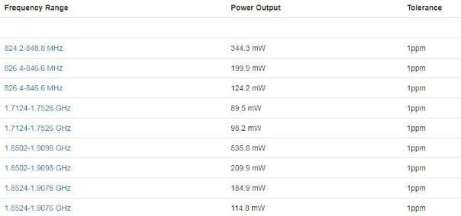
FCCID Lookup – Research
Operating Frequencies

Slide 4
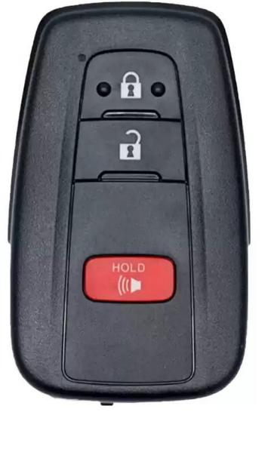
FCCID Lookup – Exercise
Take a key fob / Use your own key fob
Find the FCCID on the key fob
Search on Google
https://www.fcc.gov/oet/ea/fccid
FCCID [ID ON KEY FOB]
4. What frequency does the key fob run on?

Slide 5
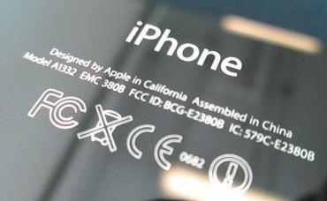
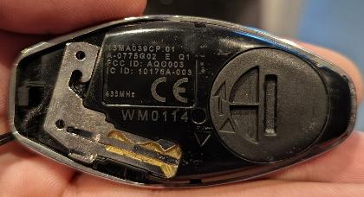
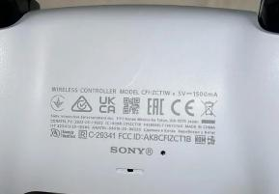
FCCID Lookup – Other Examples
iPhone FCCID
Key Fob FCCID
PS5 Controller FCCID
38

